Slide 1
RETAIL SALES ANALYSIS
SQL PROJECT

Slide 2
DATA ANALYSIS AND BUSINESS PROBLEMS&ANSWERS
SQL PROJECT

Slide 3
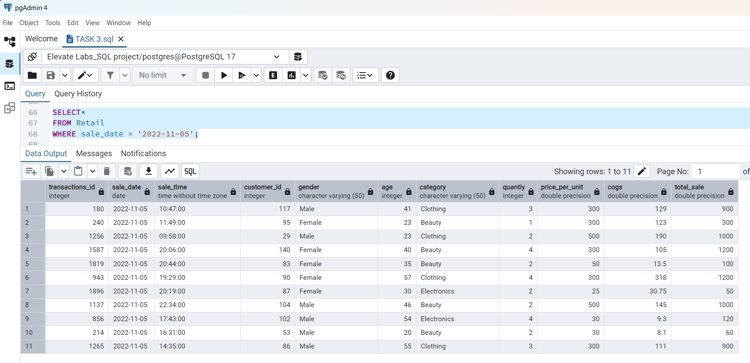
1.Write a SQL query to retrieve all columns for sales made on '2022-11-05’ SELECT* FROM Retail WHERE sale_date = '2022-11-05';

Slide 4
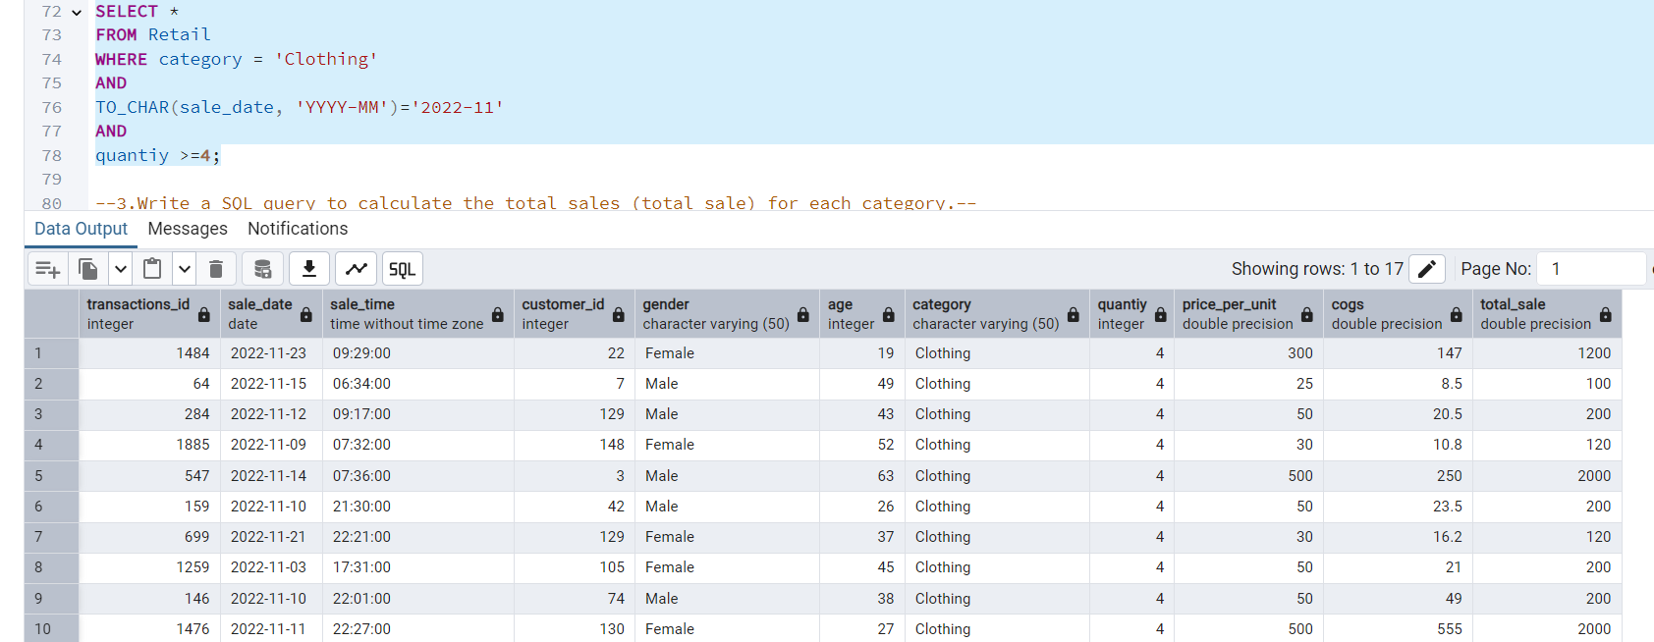
2.Write a SQL query to retrieve all transactions where the category is 'Clothing' and the quantity sold is more than 4 in the month of Nov-2022. SELECT * FROM Retail WHERE category = 'Clothing' AND TO_CHAR(sale_date, 'YYYY-MM')='2022-11' AND quantiy >=4;

Slide 5
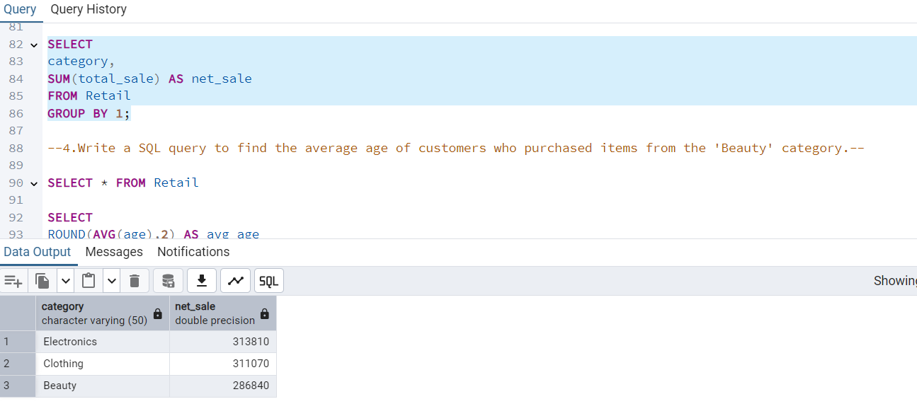
3.Write a SQL query to calculate the total sales (total_sale) for each category. SELECT category, SUM(total_sale) AS net_sale FROM Retail GROUP BY 1;

Slide 6
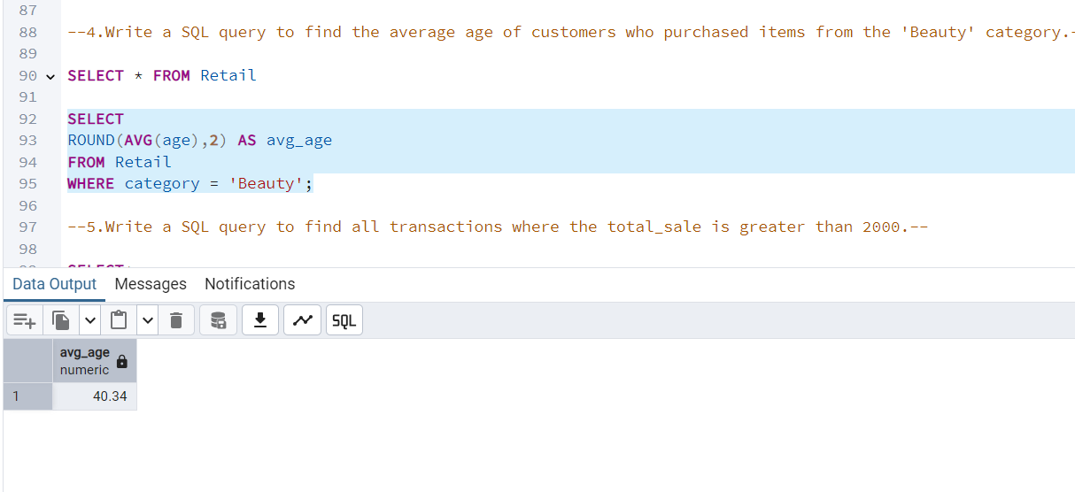
4.Write a SQL query to find the average age of customers who purchased items from the 'Beauty' category. SELECT ROUND(AVG(age),2) AS avg_age FROM Retail WHERE category = 'Beauty';

Slide 7
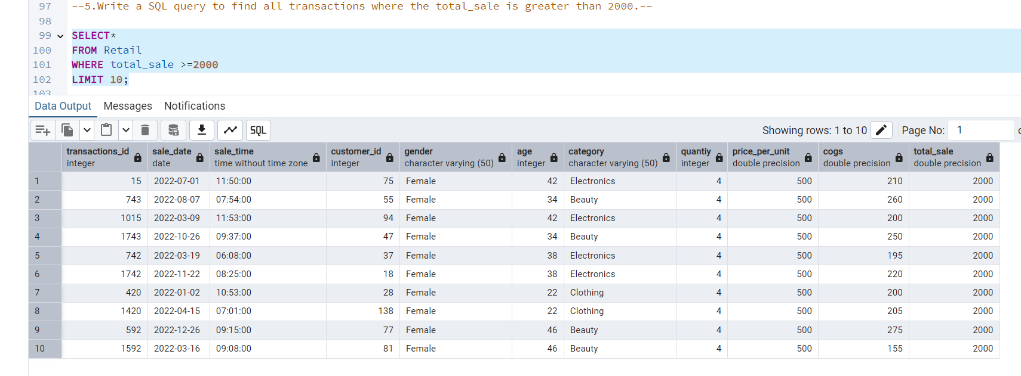
5.Write a SQL query to find all transactions where the total_sale is greater than 2000. SELECT* FROM Retail WHERE total_sale >=2000 LIMIT 10;

Slide 8
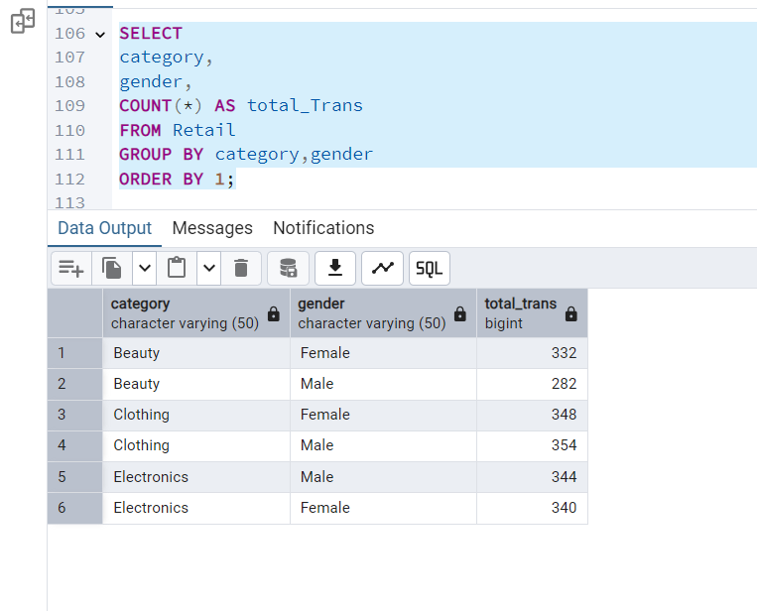
6.Write a SQL query to find the total number of transactions (transaction_id) made by each gender in each category. SELECT category, gender, COUNT(*) AS total_Trans FROM Retail GROUP BY category,gender ORDER BY 1;

Slide 9
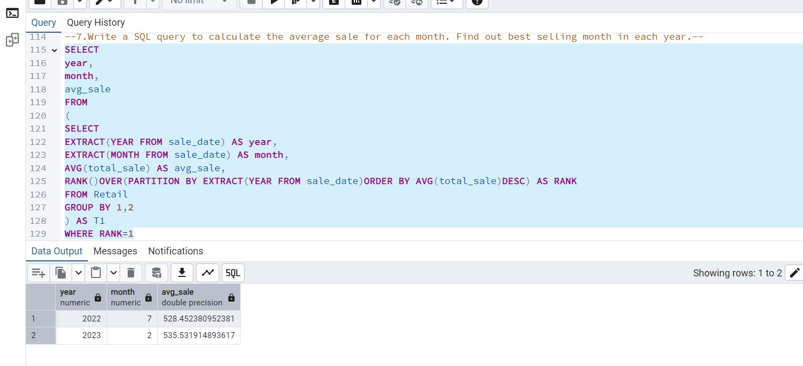
7.Write a SQL query to calculate the average sale for each month. Find out best selling month in each year. SELECT year, month, avg_sale FROM ( SELECT EXTRACT(YEAR FROM sale_date) AS year, EXTRACT(MONTH FROM sale_date) AS month, AVG(total_sale) AS avg_sale, RANK()OVER(PARTITION BY EXTRACT(YEAR FROM sale_date)ORDER BY AVG(total_sale)DESC) AS RANK FROM Retail GROUP BY 1,2 ) AS T1 WHERE RANK=1

Slide 10
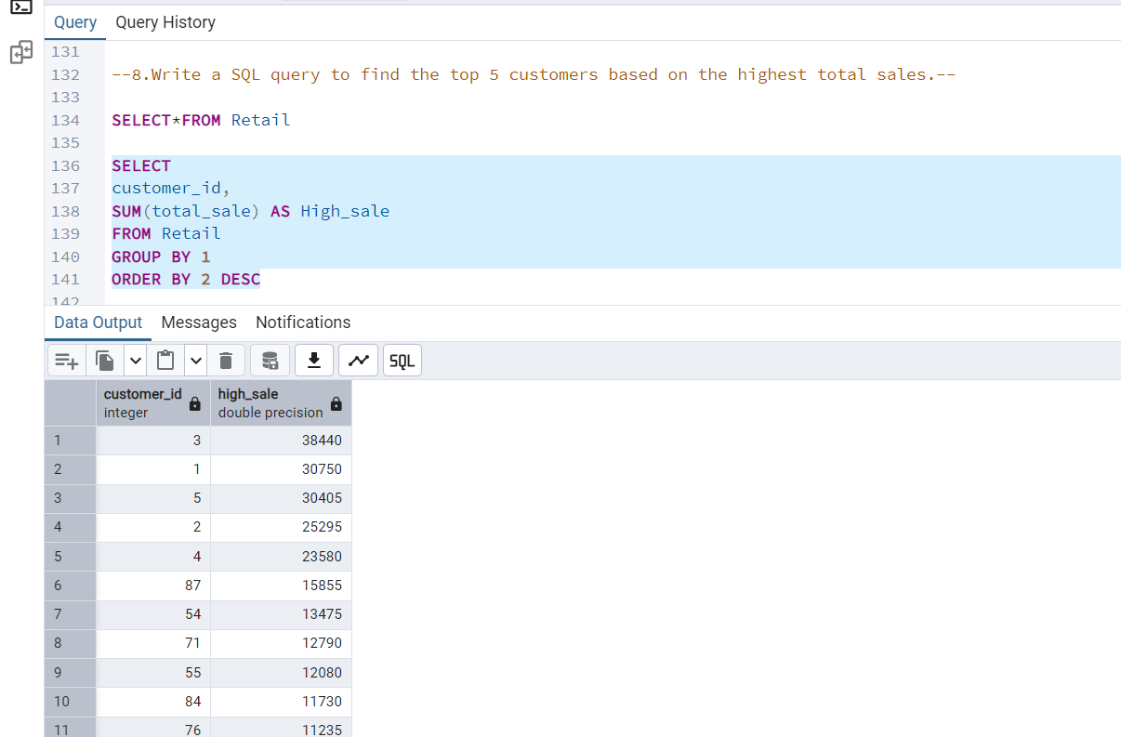
8.Write a SQL query to find the top 5 customers based on the highest total sales. SELECT customer_id, SUM(total_sale) AS High_sale FROM Retail GROUP BY 1 ORDER BY 2 DESC

Slide 11
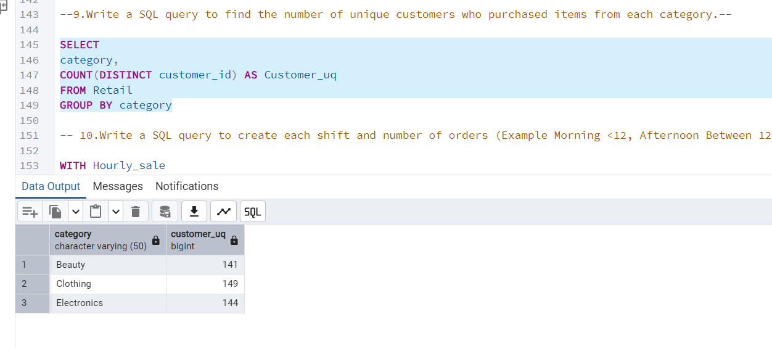
9.Write a SQL query to find the number of unique customers who purchased items from each category. SELECT category, COUNT(DISTINCT customer_id) AS Customer_uq FROM Retail GROUP BY category

Slide 12
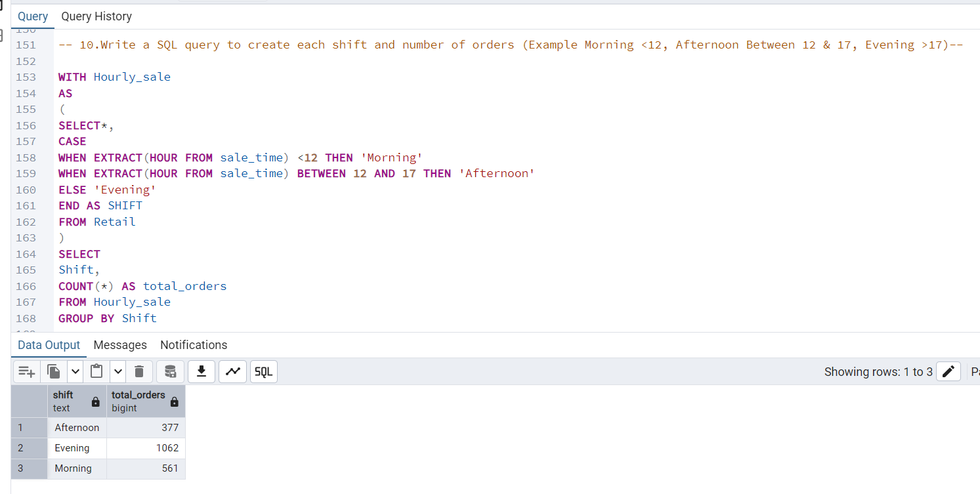
10.Write a SQL query to create each shift and number of orders (Example Morning <12, Afternoon Between 12 & 17, Evening >17). WITH Hourly_sale AS ( SELECT*, CASE WHEN EXTRACT(HOUR FROM sale_time) <12 THEN 'Morning' WHEN EXTRACT(HOUR FROM sale_time) BETWEEN 12 AND 17 THEN 'Afternoon' ELSE 'Evening' END AS SHIFT FROM Retail ) SELECT Shift, COUNT(*) AS total_orders FROM Hourly_sale GROUP BY Shift

Slide 13
Thankyou
BY DEEPANSHUL VISHWAKARMA

